Slide 1



Virtually invincible™.

Slide 2


Access education.
Access technology.
Access opportunity.
Empowering millions of learners for tomorrow’s jobs
What we do
Notes:
A lot of questions around designing a 21st century classroom. There is no real standard for it yet

Slide 3

The World at Night
Where we are (30+ countries)

Slide 4
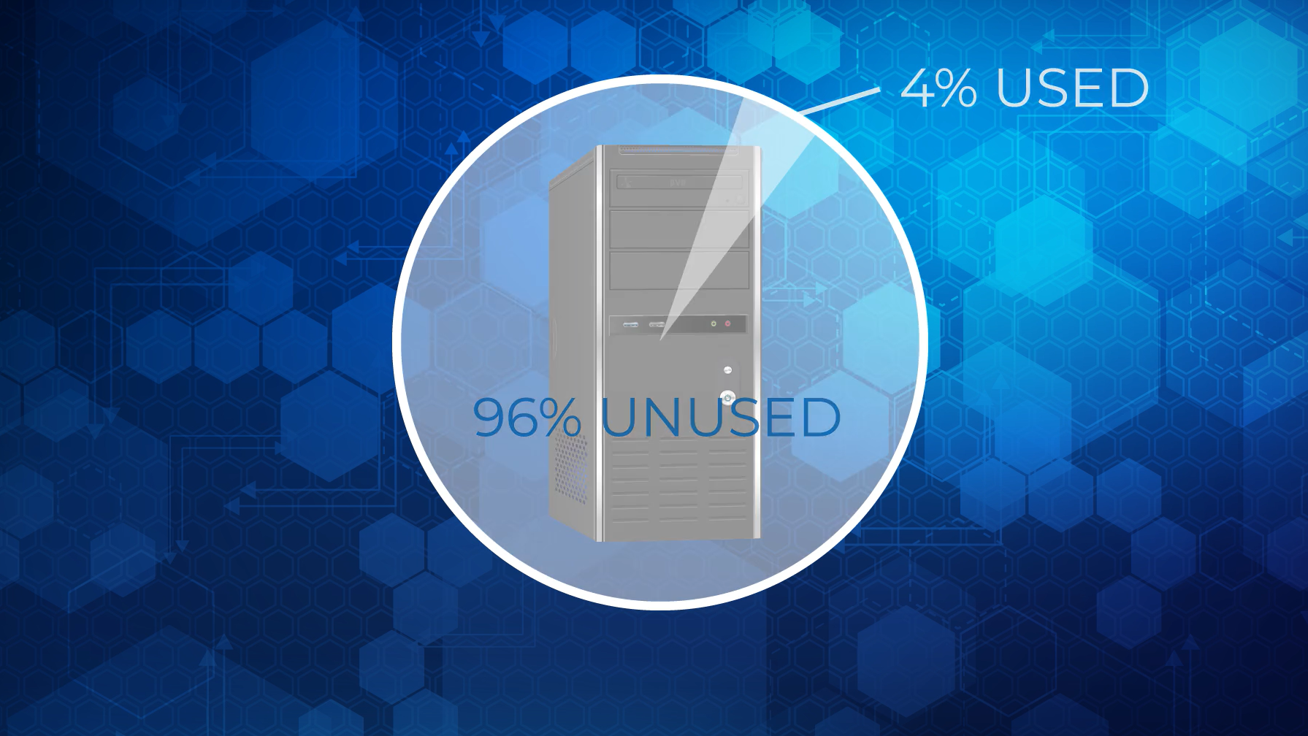
Underutilized PC capacity
Notes:
Our solution to this is Direct Virtualization…..

Slide 5
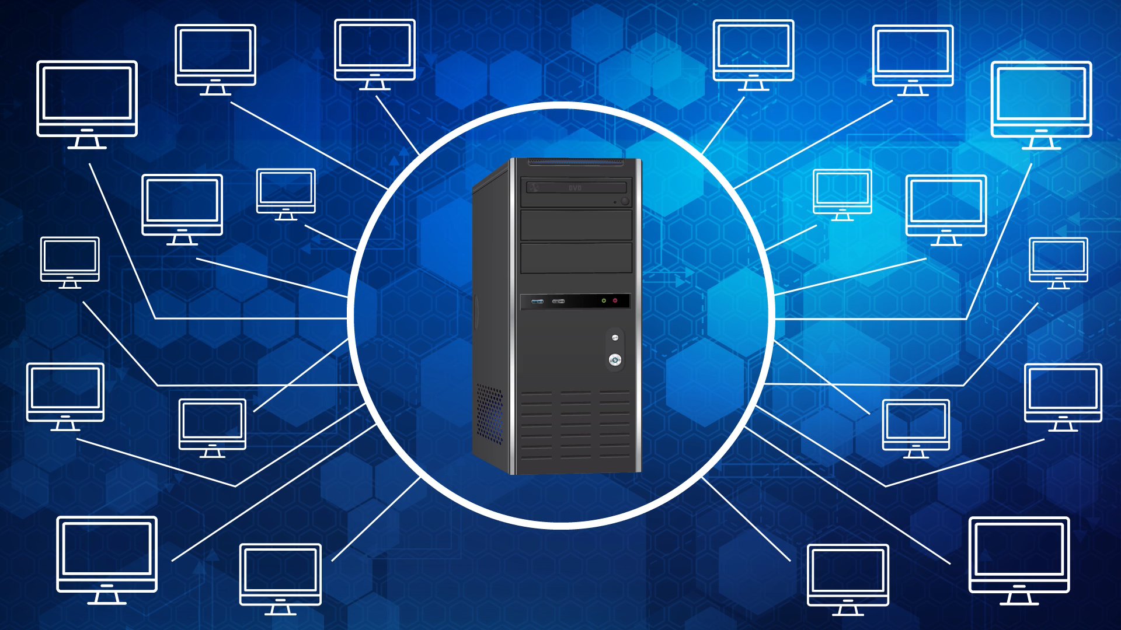
Multiply every PC by 20
Notes:
Our solution to this is Direct Virtualization…..

Slide 6
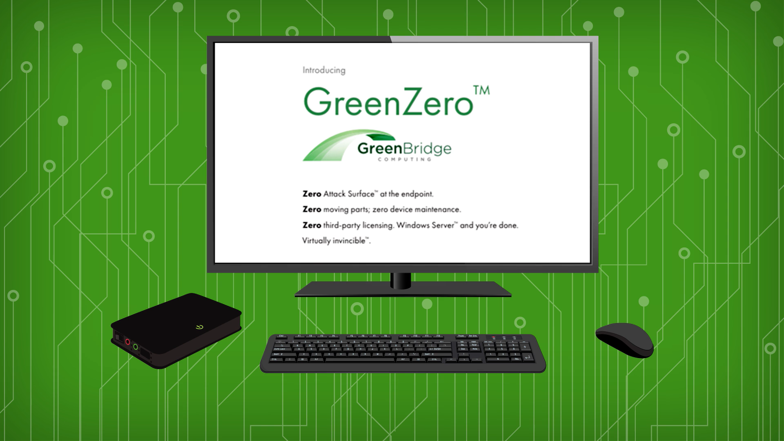
Notes:
Our solution to this is Direct Virtualization…..

Slide 7
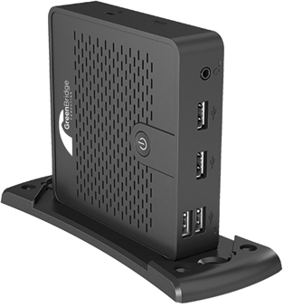
Introducing:
Earth’s most secure enterprise-class computing device
(just plug in monitor, keyboard, mouse + network cable)
Benefits:
70% budget savings / cost redirect
Zero attack surface at the endpoint
Centralized control, management, security
IT Value proposition
Notes:
Our solution to this is Direct Virtualization…..

Slide 8
Virtually Invincible:
Zero maintenance.
Zero moving parts.
Zero added licensing.
Zero operating system.
95% reduced energy use.
Meet GreenZero™.

Slide 9

Why would I want to turn 1 PC into 30?
The Market Today
Buy my devices.
Market disruption:
GreenBridge
Solution/Value | PCs | Thin clients | GreenBridge
Performance
Maintenance
Cost
Notes:
Here is a snapshot of the market today:
You have HP, who just abandoned their MultiSeat solution. Simply, put: solutions like these cannibalize their business and they’d rather sell 10 computers than one.
On the other side, you have thin-client manufacturers who are happy to keep selling $200 and $300 devices

Slide 10
User Value Matrix
Notes:
Here is a snapshot of the market today:
You have HP, who just abandoned their MultiSeat solution. Simply, put: solutions like these cannibalize their business and they’d rather sell 10 computers than one.
On the other side, you have thin-client manufacturers who are happy to keep selling $200 and $300 devices

Slide 11



Seamless integration with Microsoft
Enterprise-class software

Slide 12
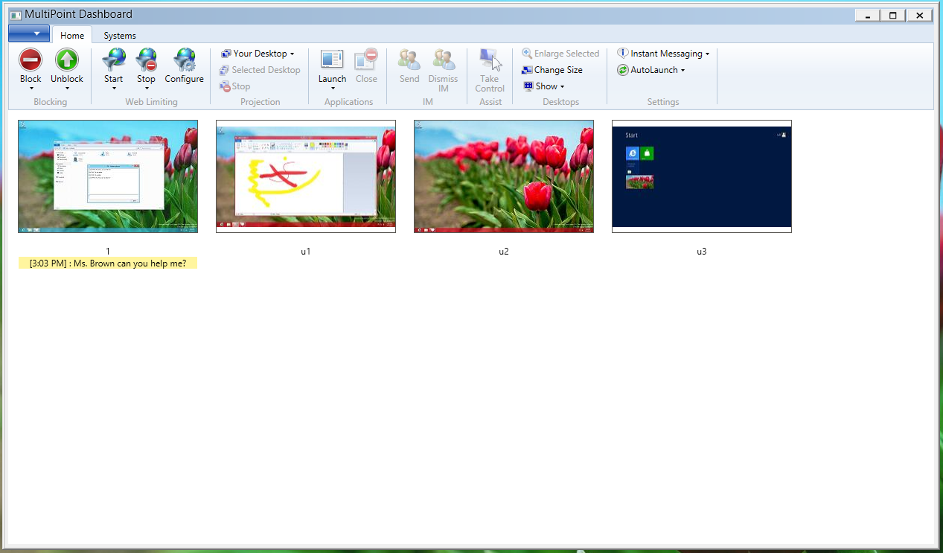

Instructor Orchestration
Monitor and control desktops. Collaborate.
Key Features
Visibility & control over stations
Manage across devices: desktops, laptops, tablets
View real-time activity
Block stations
Project stations
Launch and close apps
Limit Web site browsing
Chat

Slide 13
GreenBridge
GreenBridge
Conventional PCs
Example: 1,000 classroom rollout

Slide 14

“A superb option.”
Marty Ramos
CTO, Microsoft Retail Experience Center
Microsoft Retail Experience Center

Slide 15
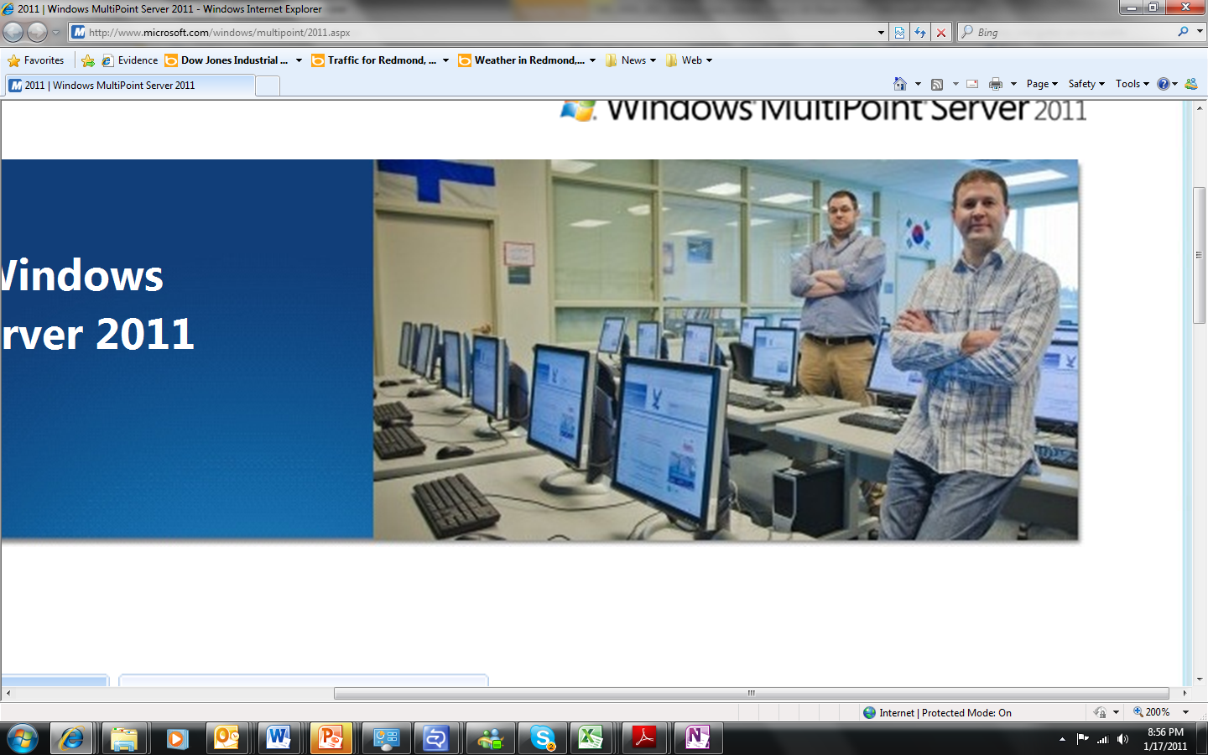
Bellevue School District, WA
In all elementary & middle school classrooms since 2011
>>
“We saved $135,000 [per school] on hardware… instead of individual desktops. We looked at VMware and Citrix... We chose [GreenBridge] based on ease of use and cost savings.”
Jason Golec, Director of Network Operations, Bellevue School District
(20,000+ students)
Notes:
One interesting story that validates this:

Slide 16

85% savings (vs VDI)
Central Oregon Community College
Laura Boehme
Director, IT Infrastructure

Slide 17
“I am so glad we did not bite off on VDI; other schools have tried it and for the investment that was made, the gains did not come. $60K per classroom is not scalable. GreenBridge is scalable.”
Laura Boehme
Director of IT Infrastructure
Central Oregon Community College

Slide 18
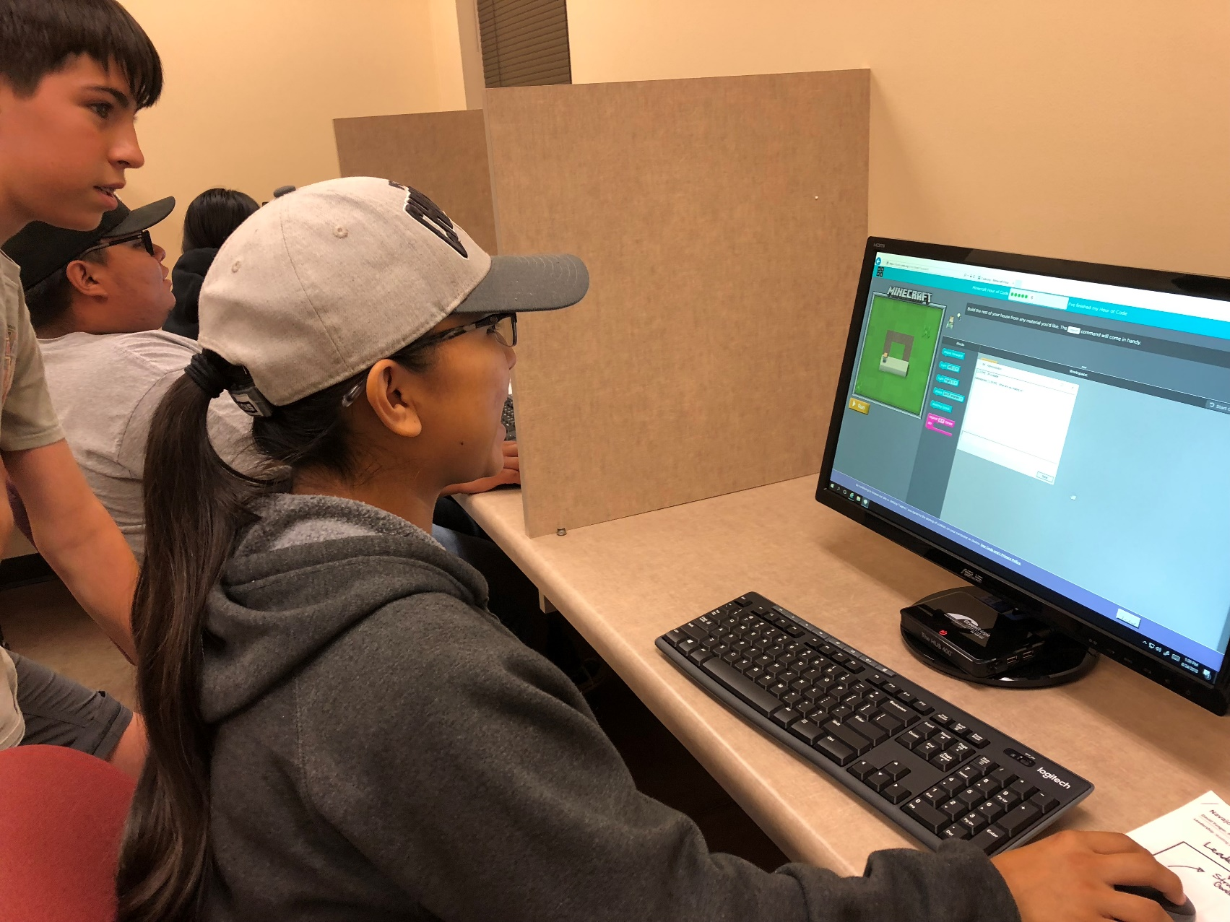
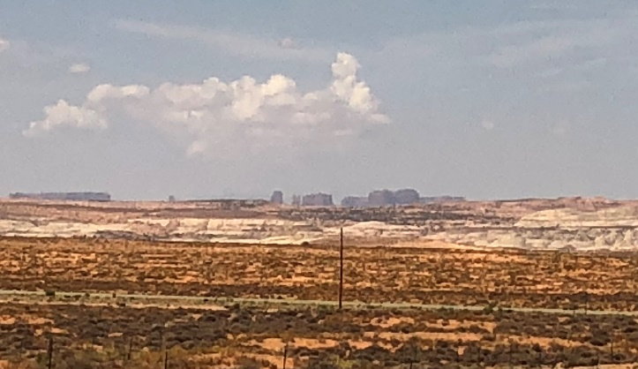
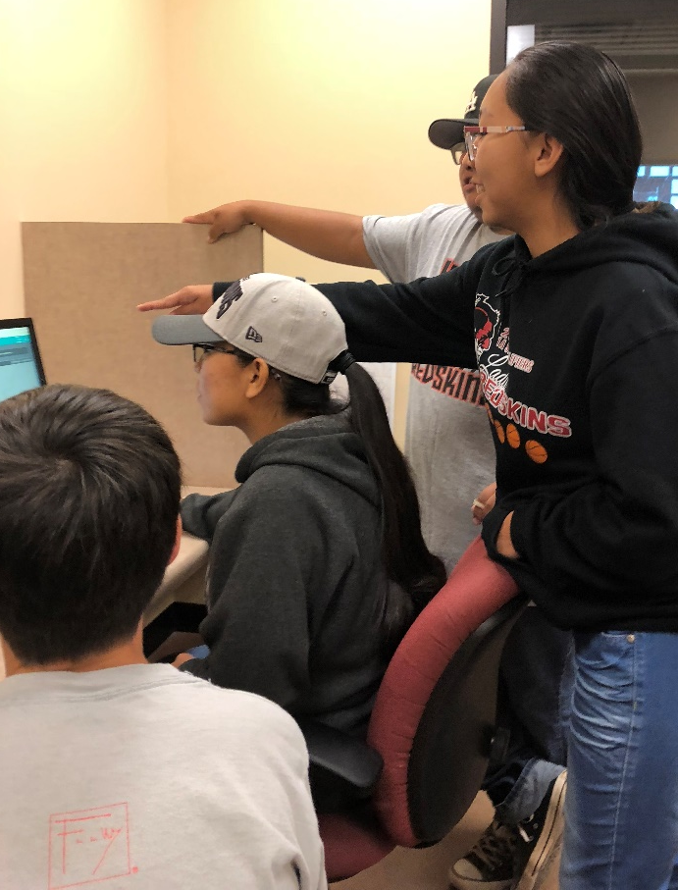
Employability partnership:
MSFT + Navajo Nation tri-state partnership

Slide 19
“"We don't have renewable funds to support 1:1. We incorporated virtual technology with GreenBridge. Zero clients will last three times as long. We didn't have enough money to continue with our labs, but now we have not only been able to get more computing in every classroom, we've also been able to keep our labs, which became extremely important when Arizona mandated online testing.
With the increase of devices we were prepared for online testing, for which we were one of the most successful districts in the state."
Matthew Peterson
Director of Information Technology
Glendale School District (Phoenix)

Slide 20
“Having served 30+ years as a Superintendent in Washington State, Virginia, and Oakland, California, I have seen a lot of vendor solutions come and go. I am convinced the GreenBridge system will save school districts tremendous amounts of money, while helping educators empower our young people with skills for the 21st century. Every classroom in America will benefit from this model.”
Milton L. Snyder, Ph.D
Superintendent (retired)
Superintendent’s perspective

Slide 21
“Deep understanding of market needs and passion for delighting customers have resulted in a number of key wins.
GreenBridge has our full support…and is addressing a vastly underserved market.”
Chris Phillips
General Manager, Windows Server
Microsoft Corporation
Microsoft Endorsement

Slide 22
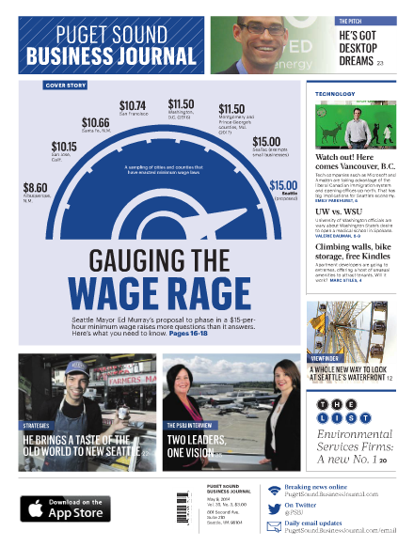
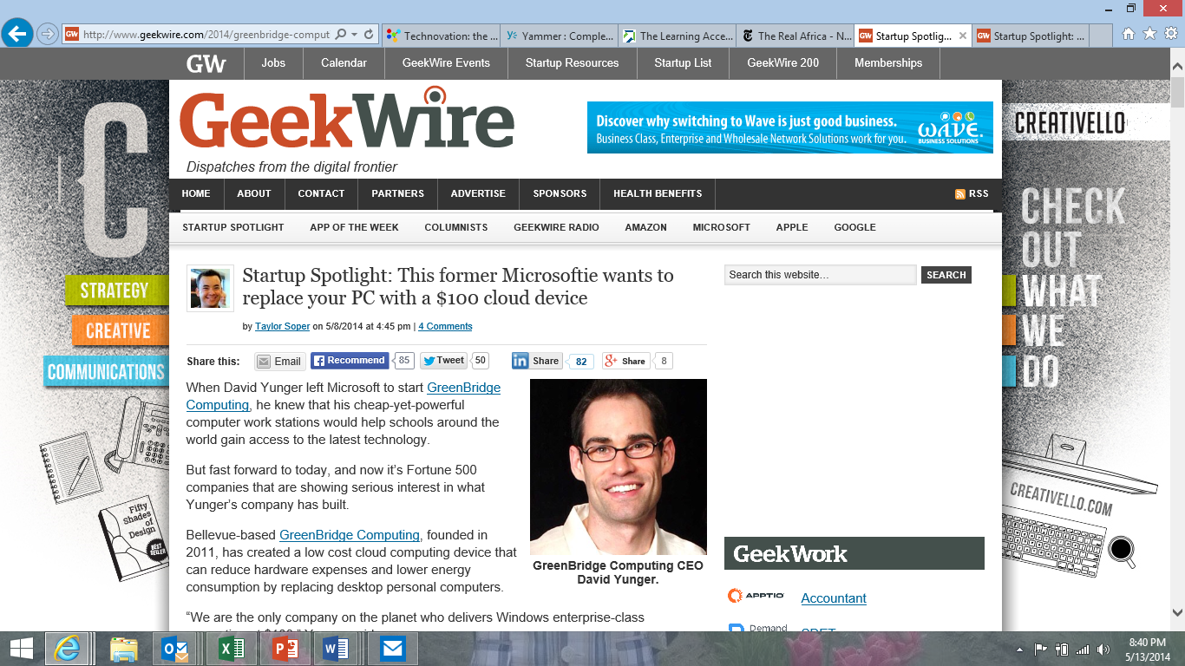

“This former Microsoftie wants to replace your PC with a $100 cloud device” -Geekwire
“The Pitch: GreenBridge bets big on desktops — with a new twist” Puget Sound Business Journal
“A Game-Changer” –Navajo Times
In the Press

Slide 23
Access education.
Access technology.
Access opportunity.
Empowering millions of learners for tomorrow’s jobs.
greenbridge.tech | info@greenbridge.tech
Next steps

Slide 24
Appendix

Slide 25
Built by former Microsoft & Pearson leaders
100,000s deployed devices
Decades of experience with Microsoft + cloud technologies
Market-leading insight integrating zero clients in enterprise environments
Backed by Microsoft:
Endorsed by Microsoft Retail Experience Center
Global alliance with Microsoft Technology Centers
Daily collaboration with Windows RDP / Windows Server engineering teams
Zero attack surface at the endpoint
Superior performance; low cost
Run “private cloud” or on-prem
Plug and play devices
Unmatched security
Expertise
Relationships
Product
Virtually invincible.
Notes:
Our solution to this is Direct Virtualization…..

Slide 26

GreenZero™ Specs
CPU | Proprietary SoC
Memory | DDR2 256 MB
Flash | 16 MB (OS Flash)
Decoder | RemoteFX video hardware decoder, H.264 hardware decoder
Firmware | μC / OS-II
Host OS | Windows Server 2016 / Windows Server 2012
VGA Connector (p to 1920x1200)
HDMI Connector (up to 1920x1200)
Support for multi-monitor?
Ethernet RJ-45 port
WiFi 2.4G Built-In | Optional add-on
AUX Audio input / output
USB 2.0 downstream (4 ports)
Power Button
Power LED
DC Power Jack (5V3A)
Mounting Bracket
Dimensions | 4.5 x 4.5 x 1.2 inches
Specifications
Notes:
Our solution to this is Direct Virtualization…..

